Slide 1
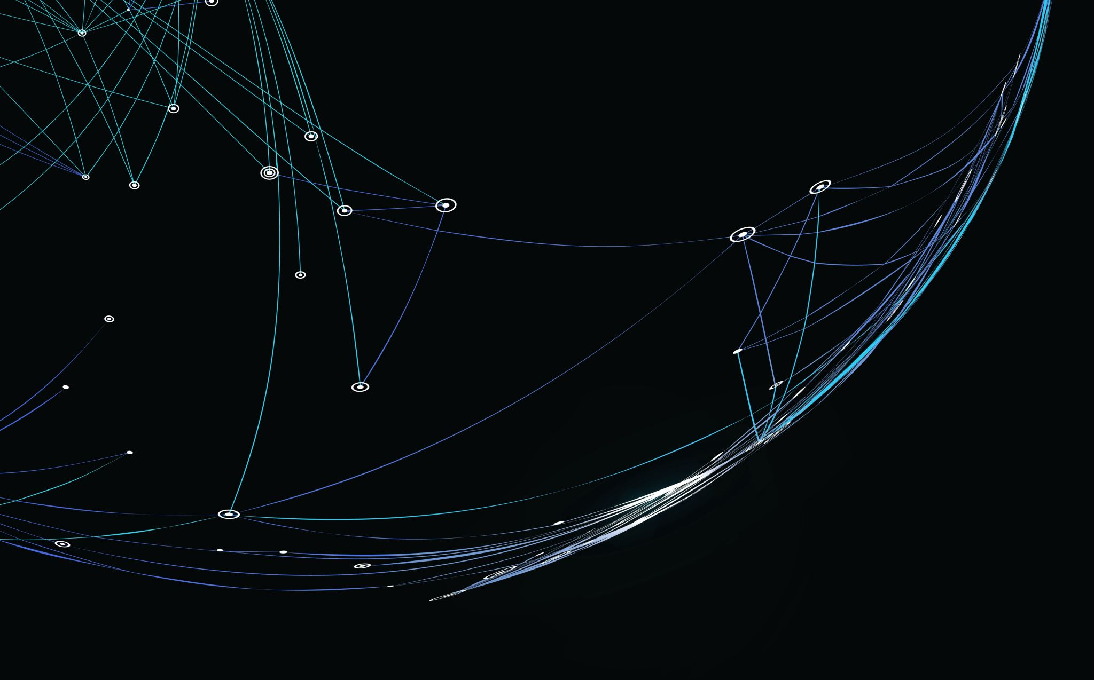
BsidesKC 2023
Badge Challenge

Slide 2
Challenges/Flags/Feature
Lockpick
Flashlight
Magnifying Glass
Camera
Notepad
Radio

Slide 3
Flags
Flag format: {bskc23}-
LP Village – {bskc23}-l3tm31nplease (L3TM3inplease)
RF Village – {bskc23}-radi0gaga (radiZEROgaga)
Scavenger hunt – {bskc23}-f0und1t (fZEROundit)
MinUSB (HHV) – {bskc23}-hwhack3r
Badge Base64 - Call 4Badges to get flag (IVR ext 48329) – {bskc23}-0p3rator (ZEROp3rator)
Text 4Badges to get different flag - {bskc23}-t3xtm3back
Email loremipsumconctf@gmail.com to get flag (auto reply) - {bskc23}-spamm3rscum
Serial Port flag – {bskc23}-g1mm3flag (gONEmm3flag)
Github flag - {bskc23}-r3poman
Steganography - {bskc23}-p1cas0 (pONEcasZERO)

Slide 4
Todo
Print flags for lockpick village
Print flags for Scavenger hunt
Print flags for RF village
Need IVR phone tree
Needs to include extensions (48329)

Slide 5
Backstory – bsideskc23-intro
In a world dominated by steam-powered machinery and intricate gears, where the advancement of technology took a different turn, cybersecurity concerns are just as relevant as in our own timeline. In this alternate reality, the Victorian era never truly ended, and instead, society embraced an aesthetic of brass, leather, and intricate clockwork. You are an Agent in this steampunk universe, known for your keen intellect and an uncanny ability to solve mysteries that baffle others. Amidst airships and steam trains, the world has also seen the rise of ‘Steamnet,' a network that allows communication across the globe. However, with this innovation comes the same risks and threats of hacking, data theft, and espionage that plague our own world. When a series of mysterious disappearances linked to a shadowy organization threaten the balance of power, you are enlisted by a secretive government agency to solve the mystery. You have been provided with a specially designed steampunk phone, a marvel of clockwork and steam technology, equipped with advanced cryptographic capabilities and a range of tools to help her on her journey. The device, called the 'Cryptophone,' is the key to solving the mystery, as it contains encrypted messages and clues that can only be deciphered by the device itself.
Your journey takes you from the bustling streets of steam-powered Kansas City to the far reaches of the empire, as you uncovers a plot that threatens not only the Steamnet but the very fabric of society itself. Along the way, you encounters a cast of colorful characters, from airship pirates to rogue inventors, and must use all your wits and ingenuity to outsmart your adversaries and crack the code. As you delves deeper into the mystery, you must confront your own past and the secrets you have kept hidden, as you races against time to stop a catastrophe that could bring the world to its knees. With the Cryptophone as your guide, you must navigate a world of intrigue, danger, and deception, in a tale of steampunk adventure, technological marvels, and a fight for the future.
bsideskc23-ctfstart

Slide 6
https://rentry.co/
bsideskc23-ctfED1T (edit) url: bsideskc23-ctfstart https://rentry.co/bsideskc23-ctfstart

Slide 7
Email
loremipsumconctf@gmail.com
Binary
01101100 01101111 01110010 01100101 01101101 01101001 01110000 01110011 01110101 01101101 01100011 01101111 01101110 01100011 01110100 01100110 01000000 01100111 01101101 01100001 01101001 01101100 00101110 01100011 01101111 01101101

Slide 8
Challenges
1. Lock Picking (pick a lock get a flag?) : You need to gain access to a secret room in an old Victorian mansion where one of the shadowy organization's members resides. Participants will need to learn basic lock-picking skills to open a series of increasingly difficult locks and reveal hidden clues inside the room. These clues will help you to piece together the organization's plan and reveal the location of their next target.
2. Soldering (min-usb): You find a broken piece of machinery that once belonged to a disappeared inventor, and it may hold essential information about the organization. Participants will need to learn basic soldering skills to repair the device and access the data stored within. By fixing the device, You will be able to uncover the organization's network and identify key members involved in the plot.
3. Scavenger Hunt (work with EagleEater) : To uncover the location of the organization's secret base, You needs to find a series of hidden objects scattered throughout the city. Participants will need to follow a series of cryptic clues, solve puzzles, and search high and low to locate these objects and bring them back to you. Each object will reveal a part of a map that, when pieced together, will show the location of the base.
4. Radio Skills (BLE CTF): The organization communicates using a special frequency that can only be accessed with a modified radio. You need to intercept their communications to learn about their plans and stop them before it's too late. Participants will need to learn basic radio skills, modify a standard radio to access the organization's frequency, and decode the messages being sent. By intercepting and decoding these messages, You can anticipate the organization's next move and stop them in their tracks.
Camera Challenge (Steganography) : You discovers that one of the members of the organization has a penchant for photography and has been secretly documenting their activities. Participants will need to locate this individual's hidden darkroom and develop any undeveloped film they find. The photographs may contain visual clues or hidden messages that can help you uncover the organization's plans and identify key members involved in the plot.
Notepad Challenge (Crypto? ): You finds a notepad that belongs to one of the organization's leaders. However, the notes are written in a code that you needs to decipher. Participants will be given a series of riddles and puzzles that will help them decode the messages in the notepad. By deciphering these messages, you can uncover the location of a secret meeting between the organization's leaders, which you can then infiltrate to gather more information about their plans.
As you navigate through these challenges, she will uncover the truth behind the mysterious organization, confront your own past, and ultimately stop a plot that threatens the very fabric of society. With the Cryptophone as her guide, you will navigate a world of intrigue, danger, and deception in a tale of steampunk adventure, technological marvels, and a fight for the future.

Slide 9
Pictures
https://photos.app.goo.gl/sdhAmbHH89FqkGjK6

